Slide 1

MRI of biliary network:
How I optimize it?
Naama Lev-Cohain MD
Dep. of Radiology
Hadassah-Hebrew University Medical Center

Slide 2
The value of MRCP over other imaging modalities:
Large field of view
High contrast resolution
Non invasively
None ionizing radiation
Notes:
High quality images independet of the patients habbitus.
The modality is important prior to ERCP- endoscopic retrograde cholangiopancreatography for better planning and anatomic evaluation

Slide 3
MR basics
T2 weighted image:
  RF pulse enables synchronized precession of protons and shift to the transverse plane
  As time passes, transverse magnetization decays and there is spin-spin relaxation
Notes:
When in an homogenic magnetic field all protons precess in the same direction as the magnet
is based on the T2 relaxation time which means that after the RF pulse is given all protons are presented in phase and in the larmore persetion. However as time passes, they start to decay and their effect on each other minimizes- transverse magnetization decay, or spin spin relaxation

Slide 4
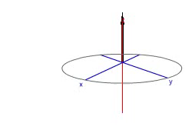
MR basics

Slide 5
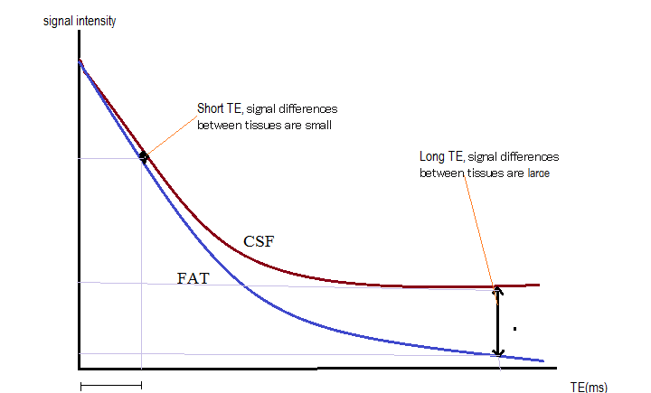
MR basics
The time to relaxation of protons varies between tissues
TE- time to echo
Short TE
Poor contrast
Long TE
Good contrast
water
TE (ms)
Notes:
for example the relaxation in water takes longer ( because the molecules move quickly and there is less field in homogenisity as opposed to fat were the relaxation is shorter

Slide 6
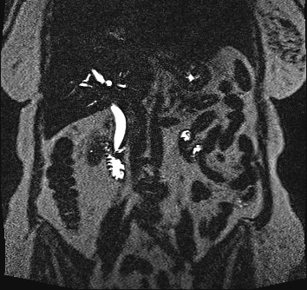
MR basics
The MRCP sequences- based on heavily weighted T2 images
Long TR and long TE
Great contrast between fluid filled structures and other structures.
Notes:
weighted T2 images which take a relatively long TR to acquire and thus provide greater contrast between fluid filled structures which have long T2 relaxation time and so hive high signal intensities and other soft tissue structures that have shorter T2 relaxation time and show low signal intensity.

Slide 7
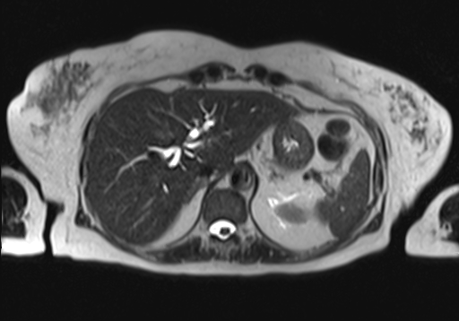
MRCP acquisition
Axial T2 W breath hold (HASTE )
Notes:
HASTE is aquired fast and so enables to eliminate the breathing artifacts.
he T2W images are prone to through-plane flow artifacts, manifest- ing as foci of signal loss in fluid-containing struc- tures. These flow artifacts are typically centrally located within the extrahepatic bile duct on axial images and are not present on coronal sequences.

Slide 8
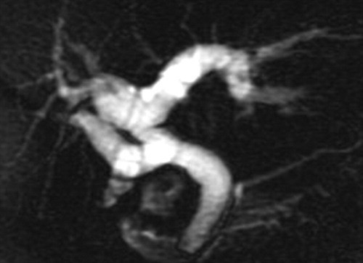
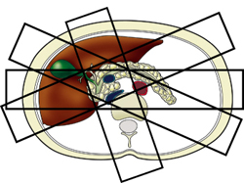
MRCP acquisition
Thick heavily T2W slices in coronal plan in breath hold
Notes:
with no need for post processing, 4-6 cm thickness. In the coronal view it is performed as a thick and very quick aquesition, there are no breathing artifacts even in hospitazed sick examinees or with inconsitensy to breath stably. However the pitfall is volum averging

Slide 9
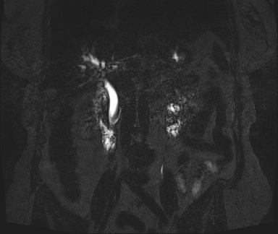
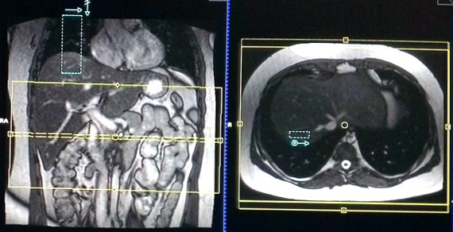
MRCP acquisition
Thin heavily 3D T2W slices in coronal with respiratory triggering
Notes:
WE ASK THE PATIENT TO BREATH SHALOW BREATHS AND WE PUT A TRIGGER ON HIS DIAPHRAGM THAT MONITORES ITS MOVMENTS. THIS TAKES ABOUT 5 MINUTES AND IS THIN SLICES OF ANOUT 1.5 MM. this enables to aquire isotropic resolution and the slices are acquired with no gaps, which USUFUL TO EVALUATE SMALL FILLING DEFECTS. From that we can also make better quality post processing like MIP
There is much higher signal to noise ratio, but takes much longer which may be a consideration

Slide 10
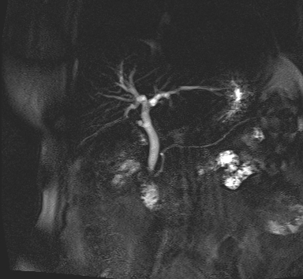
MRCP acquisition
Reconstruction- MIP
Notes:
MAXIMAL INTENSITY PROGECTION REFLECTS THE HIGHEST SIGNAL INTENSITY NAD THUS SHOW TH FLUID AND BILE FILLED OBJECTS. iT CAN BE REFORMATED IN RADIAL ARRAY.

Slide 11
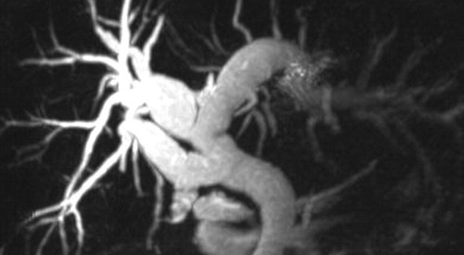
MRCP acquisition
Thick slices
MIP
Pros-
Overview of biliary tract anatomy
Identifying obstruction and strictures
Short acquisition
Minimal breathing artifacts
Pros-
More detailed image
visualize intraductal disease
Cons-
Volume averaging
Limited evaluation of subtle findings
Cons-
Free breathing
Pron to artifacts- related to post processing
Notes:
provides an overview of biliary tract anatomy and is particularly useful for identifying upstream obstruction and strictures

Slide 12
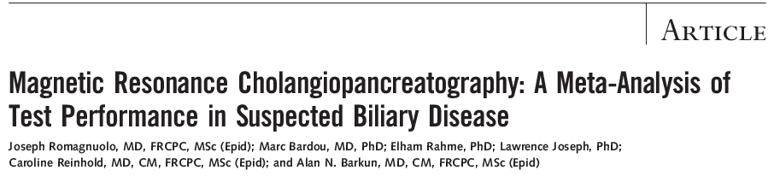

Slide 13
High sensitivity (97%) and specificity (98%) for the presence and level of obstruction
Slightly lower sensitivity (92%) and specificity (97%) for the diagnosis of stones
Differentiating benign from malignancy biliary obstruction was sensitivity (88%) and specificity (95%)
Notes:
40 STUDIES WERE REVIEWED, MORE THAN 4700 TOTAL PATIENTS.
When compared with US Ct AND ercp, it performed much better than US or CT (20and 40 vs 80) but not as well as ERCP, when comparing the evaluation with ERCP for stone detection, however it assists in evaluating who will actually need ERCP.
One pitfall is the reduced accuracy of MR cholangiography in the detection of small stones (9).
Even with thin-section 3D imaging techniques, the sensitivity for stones that are 3 mm or smaller is substantially less than for larger calculi and may be less than 50% (4).
Such small biliary stones are also missed at ERCP, with their presence often confirmed only when a blind balloon sweep brings them into view with an optical endoscope.
There are multiple studies in the literature that evaluate th use or need for MRCP prior to ERCP and almost all recommend its use since it is a non invasive tool that assits in the diceision making wether the procedure should be preformed or not.

Slide 14

Notes:
We prospectively surveyed gastroenterologists who referred patients for nonurgent MRCP for pancreaticobiliary evaluation. Before MRCP, gastroenterologists reported the working diagnosis, confidence level (high, moderate, low), and next step in clinical management if MRCP was unavailable. MRCP was performed with standard protocols, including secretin enhancement. After reviewing MRCP findings and without referring to their previous assessment, gastroenterologists reported a revised diagnosis, confidence level, and next step in clinical management. They then compared pre- and post-MRCP management plans and rated the influence of MRCP on changing management from 1 (none) to 5 (major).
Recommendations of ERCP and endoscopic ultrasound decreased after MRCP (from 49.1% to 35.1%, p=0.03, and from 26.9% to 13.5%, p≤0.01). After MRCP, high confidence in diagnosis increased (from 72/171 to 100/171, p<0.01), as did recommendations for noninvasive therapy (from 18/171 to 56/171, p<0.01). A major or substantial change in clinical management was made in the care of 67 of 171 patients (39.2%).

Slide 15
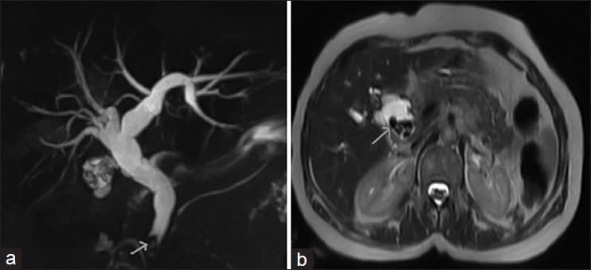
Pitfalls
MIP
T2W
Mandelia A, et al. The value of magnetic resonance cholangiopancreatography in the detection of choledocholithiasis. West Afr J Radiol 2013

Slide 16
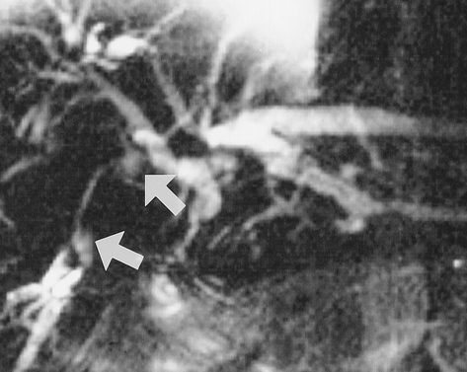
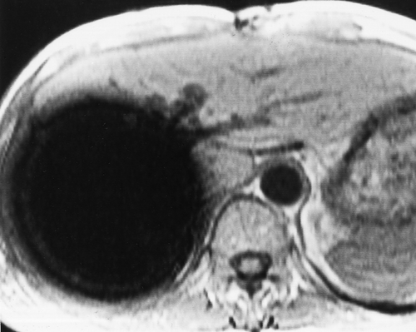
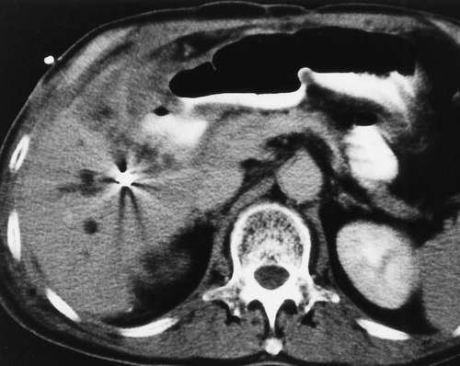
Pitfalls
MIP
T1 IF GE
Benjamin M. Yeh, et al. MR Imaging and CT of the Biliary Tract. Radiographics 2009

Slide 17
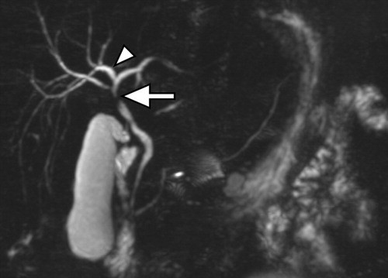
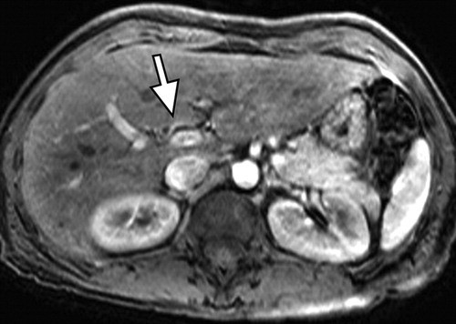
Pitfalls
MIP
T1W post c
Benjamin M. Yeh, et al. MR Imaging and CT of the Biliary Tract. Radiographics 2009

Slide 18

Pitfalls

Slide 19
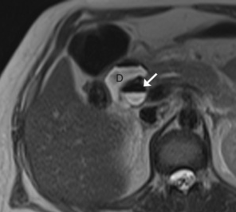
Protocol
T2 W images-
Notes:
he T2W images are prone to through-plane flow artifacts, manifest- ing as foci of signal loss in fluid-containing struc- tures. These flow artifacts are typically centrally located within the extrahepatic bile duct on axial images and are not present on coronal sequences.

Slide 20
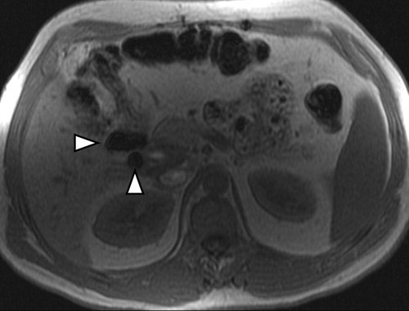
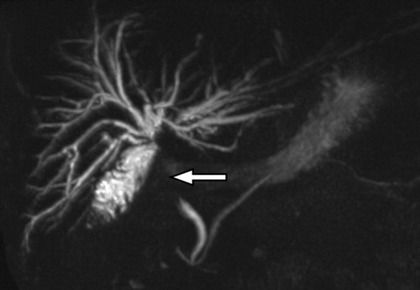
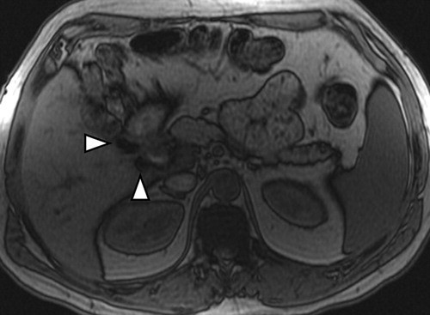
Protocol
T1 W images-
T1 IF GE
MIP
T1 OF GE
Benjamin M. Yeh, et al. MR Imaging and CT of the Biliary Tract. Radiographics 2009

Slide 21
Protocol
MIP
AX T2 FS
T1 FS PRE-C
James R. Costello, et al. MR Imaging of Benign and Malignant Biliary Conditions. Magnetic Resonance Imaging Clinics of North America 2014

Slide 22
Protocol
DWI
Notes:
accuracy = 69% vs. 93% for Reader 1 (P < 0.001) and 57% vs. 85% for Reader 2 (P = 0.002). No significant difference in the Az values and accuracy was found between MRCP and DWI combined, and MRCP, DWI, and contrast-enhanced T1WI combined (P > 0.050). There was substantial interobserver agreement in all three image sets (κ = 0.695-0.732). Improvement of approximatly 33% when DWI images were added to the MRCP images
The addition of DWI to MRCP significantly improved diagnostic accuracy in the characterization of distal biliary strictures.

Slide 23
Protocol

Slide 24
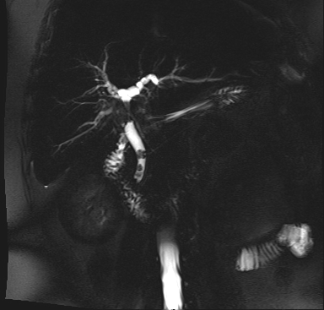
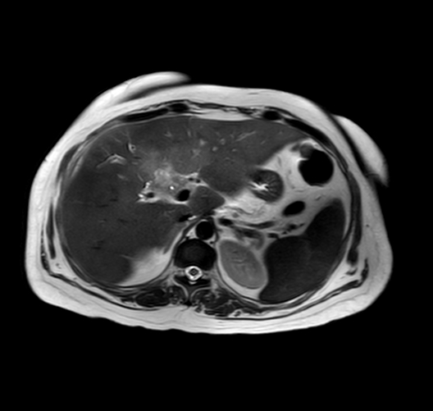
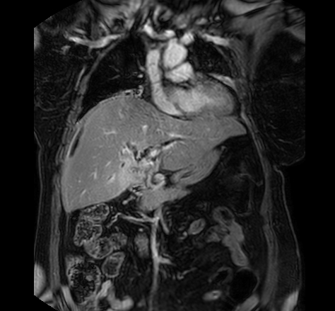
Protocol
T1W GE pre and post contrast images
T2W
T1W Post-c
T2W
T1W Post-c

Slide 25
Contrast
T1W Pre-c
T1W Post-c
T1W Post-c
James R. Costello, et al. MR Imaging of Benign and Malignant Biliary Conditions. Magnetic Resonance Imaging Clinics of North America 2014

Slide 26
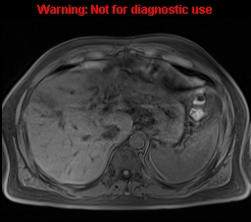
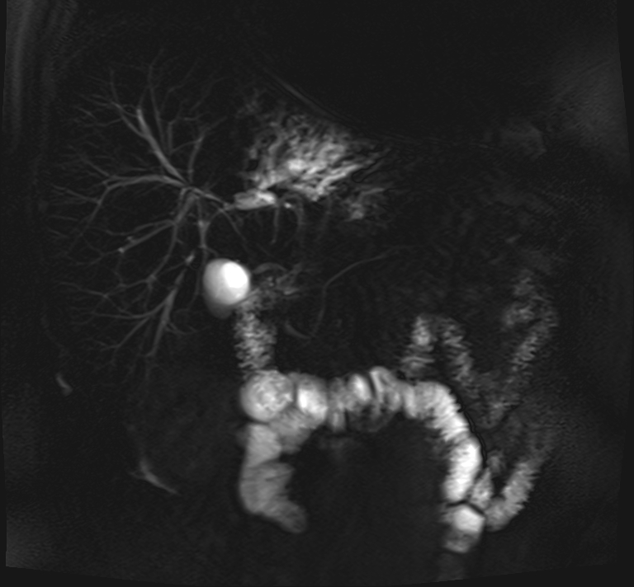
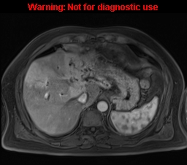
T1W Pre-c
T1W Post-c

Slide 27
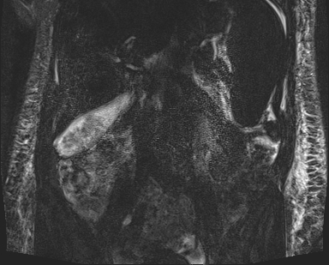
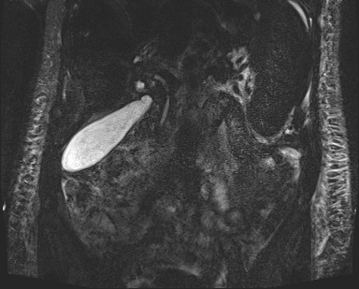
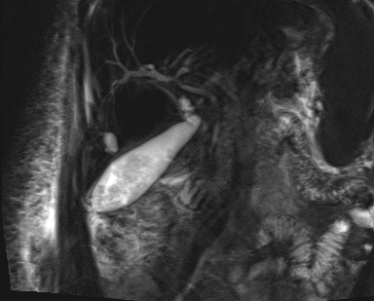
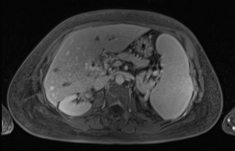
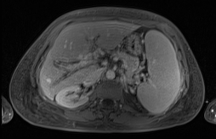
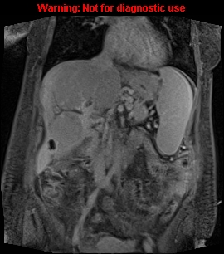
Contrast
Thin heavily 3D T2W
Thin heavily 3D T2W
MIP
T1W Post-c
T1W Post-c
T1W Post-c

Slide 28
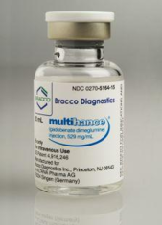
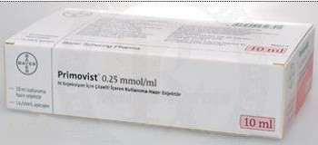
Contrast
Hepatobiliary contrast agents
Offer lesion characterization as well as functional biliary imaging
Gadobenate dimeglumine (Multihance)-
An extracellular agent
3-5% hepatocyte uptake and excreted through bile
Hepatobiliary phase after 90-120min
Max biliary enhancement after 2 h
Gadoxetic acid (Eovist) -
An extracellular agent
Up to 50% hepatocyte uptake and excreted through bile
Hepatobiliary phase after 20min
Max biliary enhancement after 1 h

Slide 29
Contrast

Slide 30
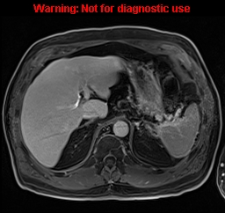
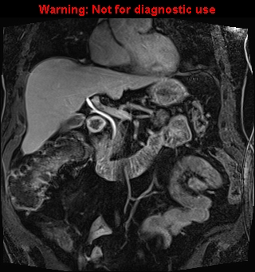
Contrast
T1 W MR cholangiography (MRC)
Notes:
hepatobiliary contrast agents offer the opportunity to image both the morphology of the biliary system and also provide functional information provided by excretion of gadolinium into the bile

Slide 31
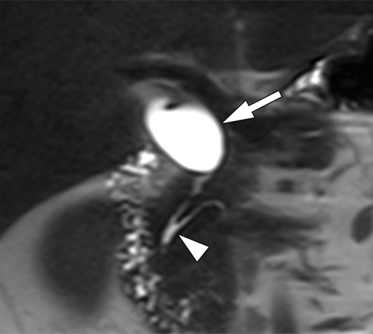
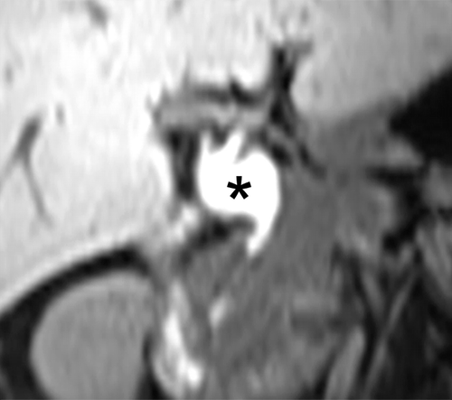
Contrast
T2w
T1w biliary phase
Nam Kyung Lee, et al. Biliary MR Imaging with Gd-EOB-DTPA and Its Clinical Applications. Radiographics 2009.
Notes:
Evaluation of biliary anatomy and detection of normal variants (Figure 13) can be of value in the preoperative evaluation of living liver donors. Normal variants of the biliary ducts
In addition, functional assessment of biliary excretion may be very helpful for the evaluation of biliary obstruction and stenoses, e.g. by tumor, stones, strictures in sclerosing cholangitis (PSC, Figure 14 and 15), post-surgical anastomosis, in the detection of traumatic or post-surgical bile leaks (Figure 16), and differentiation of cysts from choledochal cysts
Studies have shown that the T2 and T1 MRC are complimentory

Slide 32
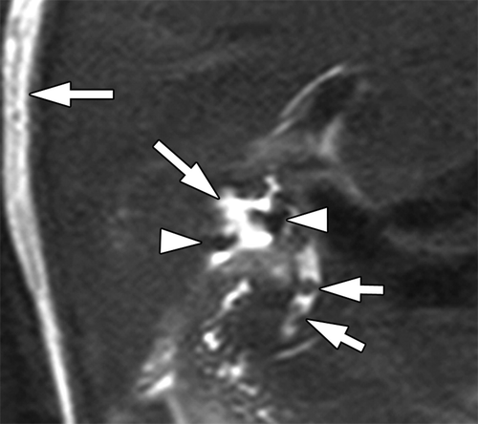
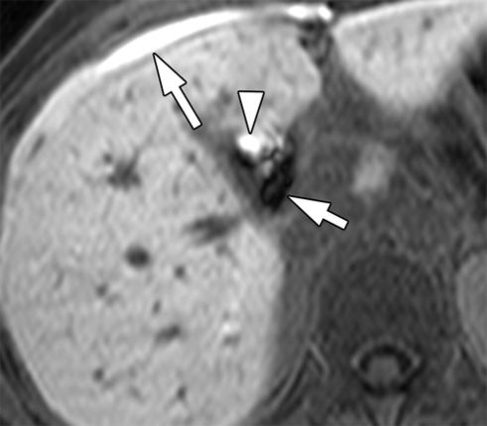
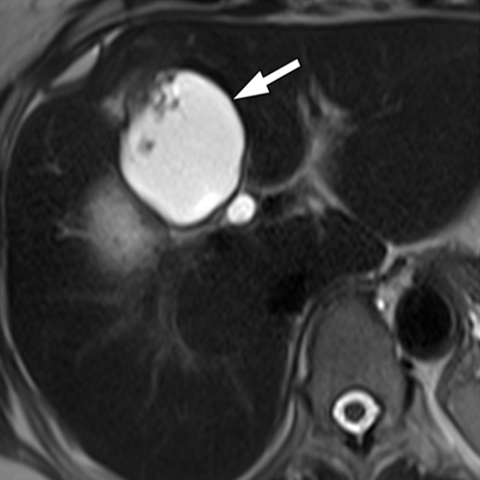
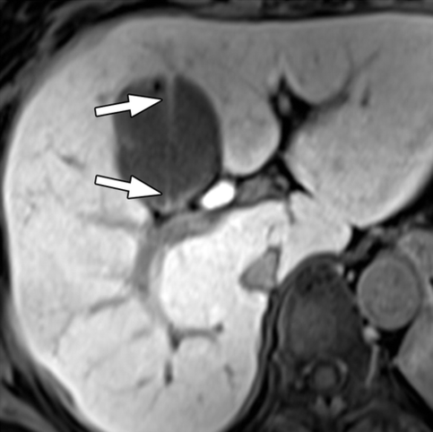
Contrast
T2w
T1w biliary phase
T2w
T1w biliary phase
Nam Kyung Lee, et al. Biliary MR Imaging with Gd-EOB-DTPA and Its Clinical Applications. Radiographics 2009.

Slide 33
Contrast
T2w
T1w hepatobiliary phase
T1w biliary phase
Shi-Ting Feng, et al. Cholangiocarcinoma: spectrum of appearances on Gd-EOB-DTPA-enhanced MR imaging and the effect of biliary function on signal intensity. BMC Cancer 2015
Notes:
Assessment of cholangioca- the lesion itself is dected as can be seen before however there is larger area that is hypointense- which can explain adjacent hepatocyts effect due to the malignat disease as well as enable use to see the function of the ivolved or uninvolved ducts-

Slide 34
Contrast
Ax T2w
Cor T2w
T1w hepatobiliary phase
T1w biliary phase
Shi-Ting Feng, et al. Cholangiocarcinoma: spectrum of appearances on Gd-EOB-DTPA-enhanced MR imaging and the effect of biliary function on signal intensity. BMC Cancer 2015
Notes:
There is thickening of the CBD with bil dil diffsely, more to the left.
On the hepatobiliary phase as well as on the biliary secrition phase there is no bile secrition but minimal contrast in the cbd which proves that the biliary function is ubnormal

Slide 35
Contrast
Notes:
The % in the % of patients from the 54 which had PSC and had hepatobiliary phase. The timing of evaluation of the % was similar in both the normal and the PSC ones.
hepatobiliary excretion of gadoxetate disodium in patients with PSC is significantly delayed, necessitating adjustments of the MR imaging protocol with regards to delayed phase imaging to obtain opa- cification of hepatobiliary segments. Contrast excre- tion correlates with bilirubin levels, and thus possibly indirectly with severity of PSC, as fluctuations in bili- rubin during the course of the disease are common. In patients with bilirubin elevation >50% hepatocyte phase images approximately 4 h p.i. may be neces- sary to achieve contrast of at least the intrahepatic bile ducts and the CBD. In patients with bilirubin ele- vation <50% hepatocyte phase images acquired 60 min after injection are sufficient in approximately 90% to obtain contrast of the respective segments.

Slide 36
Preparations
4-6 h fast
Deceases gastric fluid secretion
Minimizes bowel peristalsis
Dilates the GB
Notes:
They reduce the brightness of gastric and intestinal fluids and enhance the evidence and brightness of the biliary tree and pancreatic

Slide 37
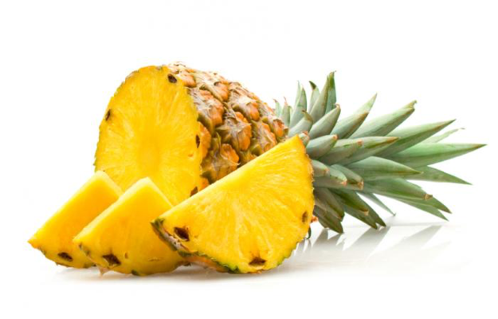
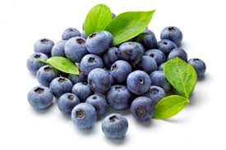
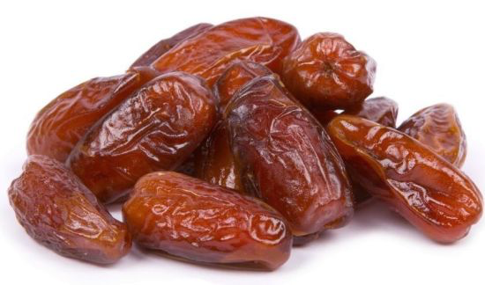
Preparations
Negative oral contrast-
High signal from bowel can limit assessment
Fluids that have paramagnetic ties
decrease the T2 relaxation time
Notes:
A number of negative oral contrast agents are available for MR imaging of the abdomen and pelvis. Many of these are relatively unpalatable, become too diluted in the gastrointestinal tract (GIT) or are expensive. Other naturally available agents have been employed. Blueberry juice is a naturally occurring inexpensive drink that at appropriate concentrations has been shown to be an effective, well tolerated negative oral contrast agent for suppressing the signal from stomach and duodenum on T2W imaging in MRCP [5–6]. Blueberry juice reduces the intraluminal signal of the GIT on T2W imaging, due to the paramagnetic proper ties of its relatively high manganese content reducing the T2 (and T1) recovery times. Therefore it may act as an effective negative contrast agent on T2W imaging (and a positive oral contrast agent on T1W imaging)

Slide 38
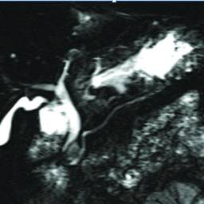
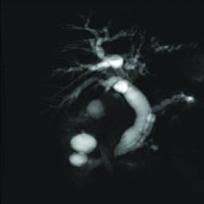
Preparations

Slide 39
Preparations
Improves pancreatic duct visualization
Provides functional information
Need to acquire every 30 sec for the 1st 5 min after injection
Notes:
The MPD is thin and is normaly up to 4 mm in head and gradually deceases towards the tail were its 1-2mm. It slightly increases with age due to pancraetic atrophy but in general its much harded to visualize it on MRCP
The secretin is a hormon that is normaly secreted by S cells in the deudenal mucosa in response to meal trigger. It causes exocrine pancreatic secrition, increases the fluid in the ducts, that will reach the deudenall papillae. Endoscopic manometry has shown increased pressure in the MPD for ap. 4 min after secrition. When the secretin is injected it causes the same effect and so enables better visualisation. It provides Provides functional information cause we see the pancrease response to secretine
causes increase in exocrine pancreatic fluids and causes by that an increase in its caliber as time goes by.

Slide 40
Preparations
T2W thick slices
3 min after secretin
5 min after secretin
10 min after secretin IV
Notes:
iNDICATIONS- CHRONIC PANCREATITIS, WHEN WE WANT TO EXCLUDE SFINCTER ISSUE, DIVISSIM, ANOMALLIES IN THE DUCT JUNCTION

Slide 41
Preparations
T2W thick slices
3 min after secretin
Notes:
CHRONIC PANCREATITS STRICTURE

Slide 42
In conclusion
MRCP has high sensitivity and specificity however:
  Always look at all the sequences
  Make sure the pathology is seen on more than a single image
  Add contrast if needed

Slide 43
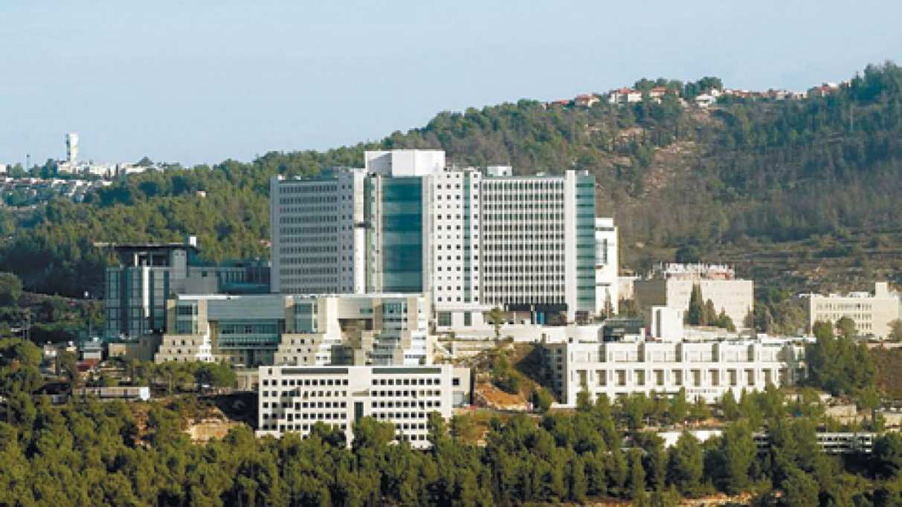
Thank you!

